Slide 1
Lists and Libraries

Slide 2
Agenda
The Purpose of Lists – What is Metadata?
Default Lists and Libraries
Employing Views
Adding and Deleting Items
Relational Lists

Slide 3
The Purpose of Lists – What is Metadata?
The purpose of lists
Defining MetaData
Why MetaData is Useful
Notes:
SharePoint 2010 uses an elemental format for storing important business information: a list. In fact, SharePoint even uses the list repository to store it’s own data. From galleries full of site, list and library templates to libraries full of master web pages and web pages that you can visit in a site…almost everything you access in SharePoint is provided by a list!
Because lists are a fundamental component of any SharePoint site, it would be beneficial as an end user for you to understand their relative importance in effectively using the site. So let’s take a look at the purpose of this versatile storage format and how lists can help you organize your SharePoint data. In the course of this discussion we’ll also explain what metadata is and it’s important role in helping you find and use the data that is stored in SharePoint.

Slide 4
Why Lists are Important
Core Format
Metadata
Customizable
Easy to Use
Views
Notes:
Lists are very flexible and can house important details about individual pieces of information you wish to store in SharePoint.
For instance, if you think for a moment about the fundamental details you would like to know about a business contact (such as the person’s name, title, company, address and phone number) these would be related pieces of data you could store in a list. Or if you knew that there was an important document that had been composed in Microsoft Office Word as a .docx file there might be additional information you’d want to learn about that document beyond just what the paragraphs actually said, such as who wrote the document, when they wrote it, how large a file it is and when it was last edited.
SharePoint lists fulfill the business need to store such details and make their relationships easily recognizable. For the business information worker, lists are invaluable because they:
Are the core format in SharePoint: both SharePoint’s internal data and user-contributed information are stored in lists;
Store Metadata: the system can react to changes in business needs more efficiently
Are easy to use: entering columns worth of detailed values in a single row to represent a single item is simple and easy
Are customizable: users with adequate permissions can add custom columns to a list to hold special details about the items in the list
Can be filtered: users with adequate permissions can create views of a list that filter, sort or group the items displayed
Using lists to store business data gives structure to otherwise unstructured details, adding value to such details and making them easier to find and work with.

Slide 5
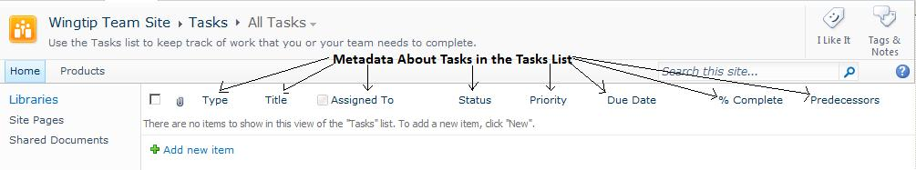
What is Metadata?
Notes:
In simple terms, metadata is merely data about other data. For instance, the details that surround a file such as its author, creation date, file size, and status of its file attributes (like Read-Only) lend relevance to the file’s actual content. Or another example might be a contacts list where you plan to store contact details (like phone number or address) for each person you enter. While you could write a separate document file for each person, that would be overkill. Instead, you can store metadata values about the person, such as their first name, phone number, address and zip code, directly into a list. In this case, the metadata about the contact is the sum of their contact information itself.
SharePoint maintains metadata about list and library items by using columns, Every column in a list represents a piece of metadata: the column title becomes the metadata property’s title as well. The column type is used to make sure metadata is entered in the correct format. SharePoint provides many pre-defined lists as templates, each serving a specific purpose by building specific columns of metadata. You’ll learn more about that later in this module.
Additionally, each list and library in SharePoint has metadata of its own that defines it such as name, description, and various list settings. In fact, all objects in SharePoint have metadata maintained about them to help both site designers and the SharePoint services recognize them. Modifying the metadata values for site objects requires an elevated level of privilege usually reserved for Designers and Administrators.

Slide 6
Why is Metadata useful?
Gives context and relevance
Can be used to find data
Can be customized
Notes:
Normally, metadata is used to give a set of data context. If you read a document that was written by Heather in the Human Resources department and it’s paragraphs discussed the payroll deduction options for the retirement and medical benefits offered by your company, wouldn’t it be easy to classify that document as a benefits paper from HR? In this case, the metadata about the document file including the name of its author (and metadata about Heather such as her department), the document’s title, and perhaps even a custom piece of metadata that identified the topics within the document with a value of “benefits” gives the document a place in the taxonomy of your company’s data. Taxonomy is simply a fancy term for classification that is used heavily in SharePoint vocabulary. Data needs to be classified in order to be placed properly among the many lists, libraries and sites of your SharePoint enterprise.
One of the side benefits of applying metadata to your SharePoint data is that it gives information workers the opportunity to search SharePoint for business data by possible metadata values. What if you needed to find only those documents that were modified on March 14th? An advanced search that sets the Modified Date metadata property at March 14th would produce a result set of those list and library items that were last modified on that date. Also, metadata values can be used to sort, group and filter the views of a list or library to give business users the ability to streamline the data they see by simply choosing the appropriate view.
And last but certainly not least, metadata can be whatever you need it to be! If you need to store details about your documents that would not normally be maintained, such as whether the document is a public or confidential paper, you can add a metadata property to your SharePoint library, name it descriptively (such as Security Level) and populate the value for each document with either the word Public or the word Confidential. You’ve just seen how SharePoint stores metadata in columns. Users with the permission to design lists and libraries can add custom columns to identify and house custom metadata about the items in the list.

Slide 7
Agenda
The Purpose of Lists – What is MetaData?
Default Lists and Libraries
Employing Views
Adding and Deleting Items
Relational Lists

Slide 8
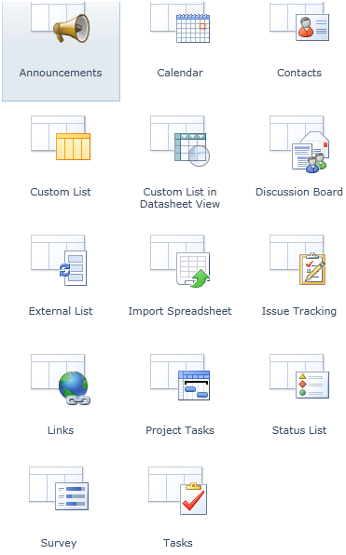
Default Lists
Notes:
SharePoint provides several list and library templates that site designers can use to build new lists. Each template is comprised of a column set designed to provide metadata for items of a specific purpose. The default list templates that ship with SharePoint Server 2010 include:
Announcements – a list of short items denoting news, proclamations, status updates or other public broadcast information
Calendar – a list of events, their dates and their details
Contacts – a list of identifying information about people with whom you communicate
Custom – a blank list template allowing you to create custom metadata columns on your own
Custom in Datasheet View – a blank list template in Datasheet View (more later)
Discussion Board – a list of threaded conversations
External List – a list based on an External content type (more later)
Import Spreadsheet – a list derived from the columns and content of a spreadsheet or workbook file created in a SharePoint compatible app
Issue Tracking – a list of problems, notes and resolutions for a given project or scope
Links – a list of hyperlinks to both internal and external web sites
Project Tasks – a list of to-do items for a given project in a default view that includes a Gantt Chart depicting gaps in the project timeline
Status List – a color-coded list of goals and achievements
Survey – a list of branched questions used to gather feedback from respondants
Tasks – a list of to-do items for a given project or scope

Slide 9
DEMO
Exploring SharePoint 2010 Lists
Notes:
In this demonstration, your instructor will give you a tour of the default lists in SharePoint Server 2010.

Slide 10
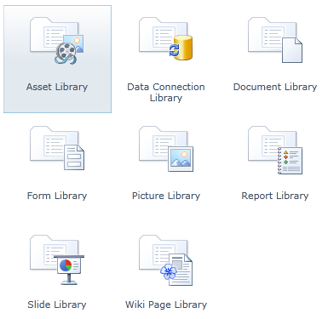
Default Libraries
Notes:
SharePoint also includes libraries, which are supersets of lists. Libraries are lists that are capable of hosting entire independent files as their items in addition to the metadata about those files. The default library templates that ship with SharePoint Server 2010 include :
Asset Library – a library designed to hold image, video and audio files as media items
Data Connection Library – a library that contains data connection information to external sources that can be shared among objects
Document Library – a library designed to hold document file types
Form Library – a library that contains e-forms created with a SharePoint compatible electronic forms app
Picture Library - a library designated to house image file types
Report Library – a library that houses pages depicting business intelligence information, graphs and charts
Slide Library – a library designed to hold slides from a slide deck created with a SharePoint compatible slides app
Wiki Page Library – a library that houses web pages for a wiki

Slide 11
DEMO
Exploring SharePoint 2010 Document Libraries
Notes:
In this demonstration, your instructor will give you a tour of the default libraries in SharePoint Server 2010.

Slide 12
Lists
Store entered values for a row in columns
Do not store files as a column value (only as attachments)
Versatile: can be created from blank using only custom columns
Notes:
Lists in SharePoint allow you to input multiple pieces of related information as a row, or item. Each piece of information is input as a value into a column of the list. Each list template in SharePoint provides a prescribed mix of columns that accept specific types of values. In fact some columns even get populated by the SharePoint services automatically (such as “Created” or “Modified By”). The columns of the different list templates are designed to serve a particular purpose, such as housing data values pursuant to a “to-do” task item or those values that define a human contact.
Unlike libraries, lists themselves do not contain entire independent files. However, some list templates support the use of an attachments column into which you can enter a pointer to a separate file on the file system. A big difference between these attachment files and the files that are uploaded into a library is that list attachments are not managed documents (you will learn more about document management later in this course).
Lists are very versatile and can hold just about any kind of business information. In fact, when site administrators construct new lists there is a Custom List template that only builds default columns then allows the list designer to add columns of various types to accommodate the unique information to be stored. By adding custom columns to lists, site administrators can provide you with the fields necessary to maintain all of your important business data in SharePoint.

Slide 13
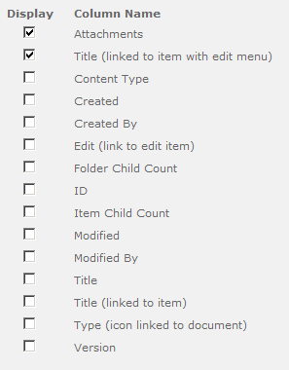
Columns
Notes:
Columns are the heart and soul of a list. They define what types of values can be stored about an item and dictate the format required for each value.
Some columns are built by default for all lists created. For example, above is a screenshot of the columns available for viewing on a Custom List. Notice that the Attachments and Title (linked to item with edit menu) columns are the only two displayed by default in the All Items view (more on views later).
Some columns are not readily displayed because they are columns in which the SharePoint services maintain the values. Take the Created and Created By columns…these two columns are populated when a new item gets created and the SharePoint server fills them in with the current date and time and the user name of the person logged into the list and adding the item.
Columns on a list can only be customized by users who have the elevated Manage Lists permission, such as site designers and administrators.

Slide 14
Libraries
Superset of the List object
Store and manage independent files
Employ Document and Content Management strategies
Version Control
Check Out / Check In
Content Approval
Sub-Folders
Notes:
Libraries are a special kind of SharePoint list that has the ability to store an entire independent file as one of its column values. There are different libraries designed to house different categories of files. SharePoint Server 2010 ships with various default library templates, each predefined to store a certain kind of file (such as documents or images). Any file of a filename extension that is not being blocked at the SharePoint farm level can be uploaded into a library.
Libraries offer the same custom column types as lists and can be modified to include custom metadata about their items. Certain metadata columns (such as “Created” or “Modified By”) will be populated by the SharePoint services. Others will need to be entered when the file is created or uploaded into the library.
One big difference between libraries and lists is that there is no blank Custom Library template. All libraries must be derived from one of the system-supplied library templates. Also, libraries are configured with a “Default Document Template” that specifies what kind of file will get generated when a user clicks “New” on the toolbar of the library. Lists are not configured with default document template settings because they do not contain entire files as values.
But perhaps the most notable advantage of libraries is the document and content management opportunities they offer. Libraries include the ability to keep past versions of their items (both the file and its metadata), just in case you need to reverse changes you made by restoring a previous rendition of the file. And to prevent two business users from attempting to change the same library item simultaneously in different ways, which result in a conflict, libraries support a Check Out process that will lock an item for editing by only a single user. While the user is editing the item, other visitors to the library may only read the item (and they’ll be reading the item as it looked prior to the editor checking it out of the library). When the user editing the document finishes, they can Check In the file so that their changes update the library item for all.
Some managers or library administrators may wish to enforce oversight over the files stored in the library as well as any changes made to their metadata values. Like some lists, libraries possess a configuration option that can be set by the library administrator called Content Approval which will hold all new and updated items in a Pending status until someone with the approve items permission opens the item and either approves or rejects it for the library. If the pending item isn’t new but rather is an update to an existing item in the library, then users will continue to be able to read and even edit the rendition of the file prior to the pending updates being made.
Also like some lists, libraries give users the opportunity to organize multitudes of items into sub-folders. Users with the permission to contribute to the library will see a New Folder option in the New drop-down menu from the library’s toolbar if the library administrator has enabled sub-folders for the library.

Slide 15
DEMO
Working with SharePoint 2010 Document Libraries
Notes:
In this demonstration, your instructor will create sub-folders and manage items in an already populated library.

Slide 16
Agenda
The Purpose of Lists – What is MetaData?
Default Lists and Libraries
Employing Views
Adding and Deleting Items
Relational Lists

Slide 17
Employing Views
Filter the display of items in a list or library
Alter the appearance of list and library web parts
Isolate metadata exposure on items
Organize items using sorting, grouping, and totaling features
Optimize item display for mobile client devices
Notes:
Views are subsidiary components of lists that can be invoked for the purpose of altering the way items are displayed.
Both lists and libraries are built with at least one default view called All Items. In fact, some lists actually construct multiple views by default such as the Tasks list. The All Items view displays a prescribed collection of columns from the list for all items in the list. Each list type dictates a different collection of columns.
When a more focused adaptation of the list is needed, a custom view can change the amount of metadata (i.e. columns) that is displayed for each item as well as organize and even filter the items to lend context in a heavily populated list. And though sub-folders also organize items, folders differ greatly from views. While it’s true that folders become items within the list itself and therefore can have granular permissions defined for them, whereas views do not, views give their designer many more options than folders to filter, group, sort, and even perform functions against the items that will end up in the view.
Views offer the following categories of customization:
Name – Type a descriptive yet concise name for the view
Columns – Select which columns of the list are to appear in the view
Sort – Select which column(s) will define the sort order of the items
Filter – Define criteria that an item must meet in order to appear in the view
Inline Editing – Set whether an edit button should appear on each row
Tabular View – Set whether checkboxes should appear on each row for selecting items
Group By – Select which column(s) to group the items by
Totals – Set which columns will get a total value generated for them
Style – Select a format style for the view
Folders – Set whether to expose folders in the view or lump all items together
Item Limit – Set item batch limits or a maximum number of items that will appear in the view
Mobile – make the view adaptable to mobile device screen limitations

Slide 18
Public vs. Personal Views
Public Views
Personal Views
Available to all readers of the list
Can only be created by users with Manage Lists permissions
Can be marked as the default view for all visitors to the list
Available only to its creator
Can be created by any user with the Manage Personal Views permission
Cannot be the default view for all visitors to the list
Notes:
List designers and site administrators can create additional custom views for any list or library. In fact, users who have been granted the Manage Personal Views permission, such as those with the contribute permission level, can create custom views for their own personal use.
Personal views allow you to create a rendition of the list’s appearance that best suits the way you, the business information worker, interact with the list. Not all columns worth of metadata values will be important to your use of an item. Why waste your screen space with columns you aren’t interested in? And not all groups of items will be necessary for your immediate information need, so why have to scroll down through hundreds of items to find the ones you want?
Plan your views carefully. You should try to create the minimum number of views necessary so as not to actually degrade your own productivity by missing pertinent items because you have too many views to choose from!

Slide 19
View Types
View Type | Description
Standard | Tabular view of rows and columns
Calendar | Expandable wall calendar format in day, week, and month
Datasheet | Editable spreadsheet format
Gantt | Standard view with a Gantt Chart timeline to plot progress
Custom | Built in SharePoint Designer 2010
Notes:
SharePoint 2010 provides five view styles to enhance a list or library. When you create a personal view, you can choose from the styles seen above. Be sure to choose the style that lends itself best to your own productivity.
Keep in mind, however, that not all view styles are appropriate for all lists. For instance, the calendar view style looks like a wall calendar and is only appropriate for lists that contain date information about items. Similarly, the Gantt view uses date values to plot items along a timeline, showing where items overlap or where there is a gap between the end date of one item and the start date of the next. Thus, the Gantt view style would not be appropriate if you are not maintaining start and end date information about your items.
The Datasheet view of a list or library is available from the List ribbon at any time.

Slide 20
DEMO
SharePoint 2010 List Views
Notes:
In this demonstration your instructor will explain the different view types and display samples.

Slide 21
Agenda
The Purpose of Lists – What is MetaData?
Default Lists and Libraries
Employing Views
Adding and Deleting Items
Relational Lists

Slide 22
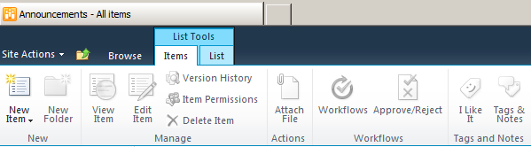
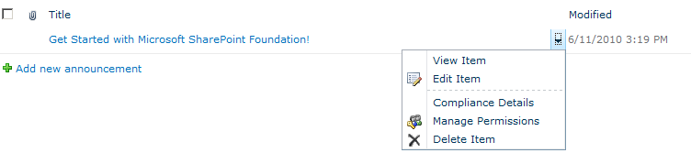
Adding and Deleting Items
Notes:
When you need to interact more with a list than simply reading its existing content, you may find it necessary to add or delete items. Contributing to the item makeup of a list requires elevated privileges and should be carefully monitored to avoid duplicate, inappropriate, or unnecessary items from detracting from the list’s efficiency.
SharePoint 2010 provides two (2) separate permissions entitled Add Items and Delete Items that give the benefactor of such authority the ability to insert items into a list or remove items from a list respectively. There is also a Permission Level in SharePoint 2010 called Contribute that bundles these two influential permissions along with many others to allow principals who have been granted the permission level to manage list content. When SharePoint 2010 sites are created a SharePoint Group called {Site Name} Members is automatically generated and granted the Contribute permission level. It is then up to the Site Administrator to add individuals’ user accounts into the Members group to give them the authority to manage list content.
All of that being said, one of the selling points of SharePoint 2010 is its flexibility and versatility. There is no guarantee that your Site Administrator has not redefined the site permissions beyond the defaults assigned during site creation. One way you’ll be able to tell if you have the permissions necessary to add and delete items is if the links appear on the Item Ribbon of the web interface. SharePoint 2010 employs what is called a security trimmed interface, which means if you don’t have the necessary authority to perform a task or function, then the link necessary to engage that task is trimmed from your view.

Slide 23
Editing Items
Notes:
Modifying existing list items in SharePoint 2010 requires the Edit Items permission, which is part of the default Contribute permission level. You may assume that a user maintains the authority to edit any item they, themselves, have added to the list. But this may not necessarily be the case. If the user was a member of the {Site Name} Members SharePoint group and that group has its default Contribute permission level assignment, then they can both add and edit items (both those items they added themselves as well as items added by other contributors).
But if the Site Administrator has set permissions granularly, it is possible that a business information worker may have the Add Items permission to contribute new items to the list but thereafter has no authority whatsoever to edit any items, including their own. A possible scenario for such tight permissions may be where users are encouraged to post initial reactions to a procedure and the list owner wants honest first impressions. By preventing users from being able to edit their item in the future the list is more likely to contain candid responses.
Also, you should carefully consider before editing an item’s values. Remember views and how they can be used to filter items? Changing the value of a specific column could cause the item to be filtered right out of your current view or re-sorted unexpectedly. Be sure you know what the effect of your potential change will be prior to making the edit so that you do not inadvertently cause the list to perform inefficiently.

Slide 24
Agenda
The Purpose of Lists – What is MetaData?
Default Lists and Libraries
Employing Views
Adding and Deleting Items
Relational Lists

Slide 25
Relational Lists
SharePoint 2010 introduces the capability to have a relationship behavior enforced by Lookups
New investments:
Projected fields into child lists
Joins
Relational integrity between parent & child lists
Introduces new security considerations and possible issues
Notes:
In SharePoint 2010 you can use Lookup fields to enforce a relationship behavior between two lists.
In the SharePoint API there have been changes to make these relations possible. The SPList class has and additional method GetRelatedFields that returns a collection of type SPRelatedFieldsCollection. A field of type SPRelatedField has properties like FieldId, ListId, LookupList and RelationshipDeleteBehavior.
The SPQuery class has been extended with additional properties like ProjectedFields and Joins. The ProjectedFields property returns the related fields from the joined list, so that they can be referenced in the WHERE element and the ViewFields element. Each projected field is represented by a Field object. The Joins property includes Join elements. SharePoint allows inner joins and left joins.
When creating a lookup, you can enforce relational integrity between parent and child list in two ways:
Can enforce a cascade delete.
Can restrict delete relationships.

Slide 26
Relational Lists: Projected Fields
Projected Fields
Extra field pulled from parent list into view of child list
Via browser interface, users add a lookup from another list just like WSS 3.0…
Then, user can select a secondary lookup field to pull into the child list
Notes:
Projected fields are fields from a parent which are referenced and displayed in the child list.
When a user add a lookup field to a list, the user can select a parent list, just as in WSS 3.0. But additionally, the user can select one ore more additional fields from the parent list to be visible in the view.
These fields are read-only, but enable a more join-like view.

Slide 27
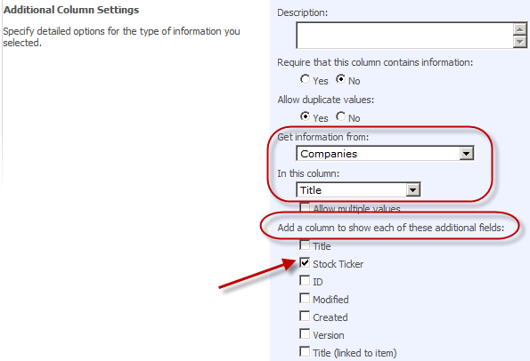


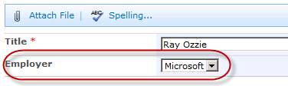
Relational Lists: Projected Fields
Notes:
When creating a new lookup field, the user selects the Companies list to select information from. Additionally the user chooses to also display the Stock Ticker field from the Companies list.

Slide 28
DEMO
Creating Relational Lists
Notes:
In this demonstration your instructor will illustrate create relational lists via lookup columns.

Slide 29
Summary
The Purpose of Lists – What is MetaData?
Default Lists and Libraries
Employing Views
Adding and Deleting Items
Relational Lists

